Slide 1

Distributions of Products in various Regions and their Sales.
BY- SRIHARIKA MARIYALA

Slide 2
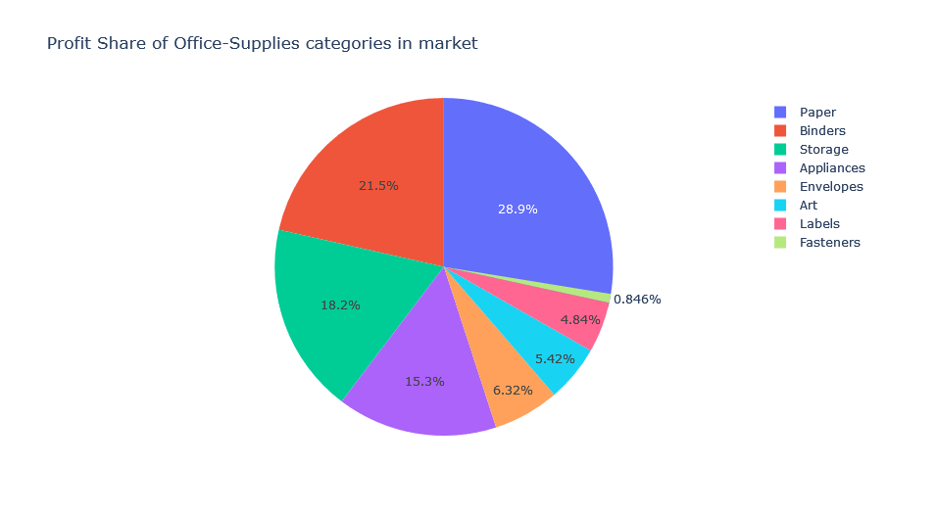
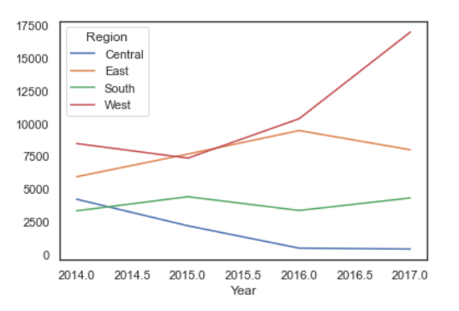
What motivated for this analysis?
Profits by Year
Profit

Slide 3
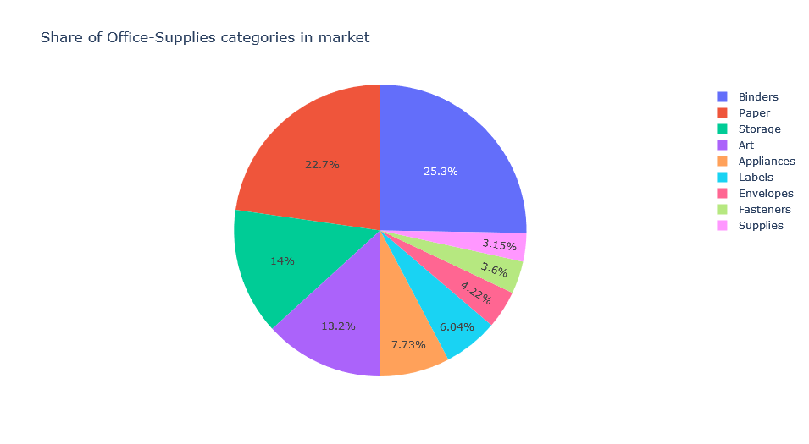
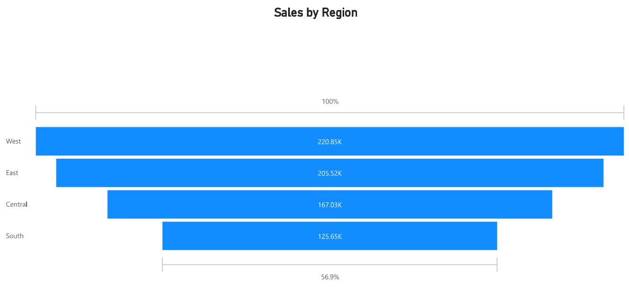

Slide 4
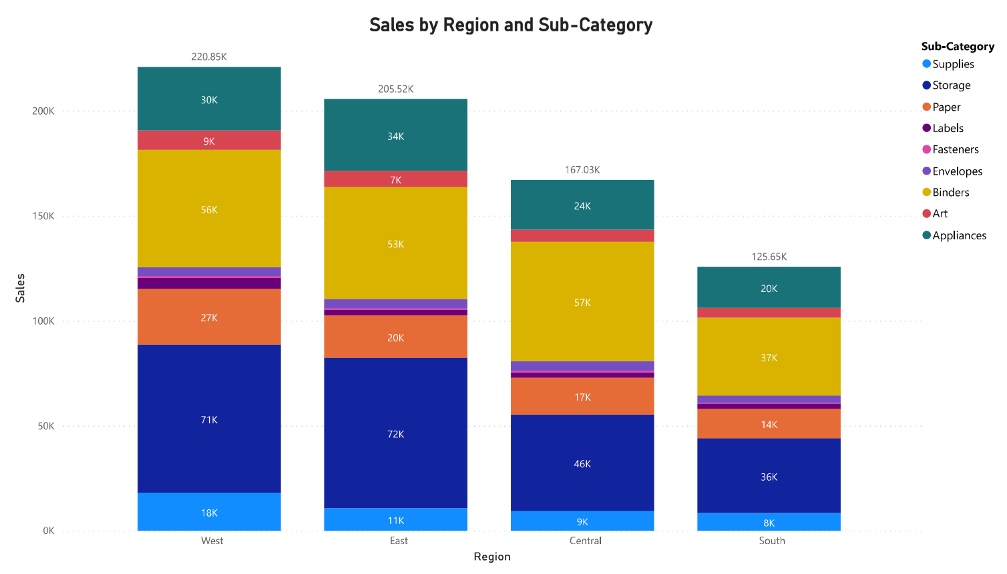
Page 1
1st Insight:
Unsold products are in following categories:
Fasteners, Envelops, Labels and Supplies.
Notes:
columnChart
No alt text provided

Slide 5
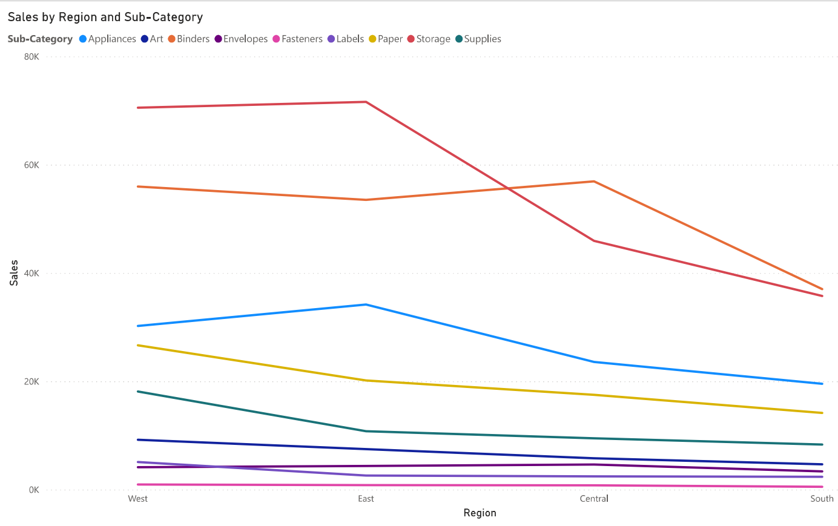
2nd Insight:
Categories like Binders, Storage and Appliances don’t sell well in Central and South regions.

Slide 6
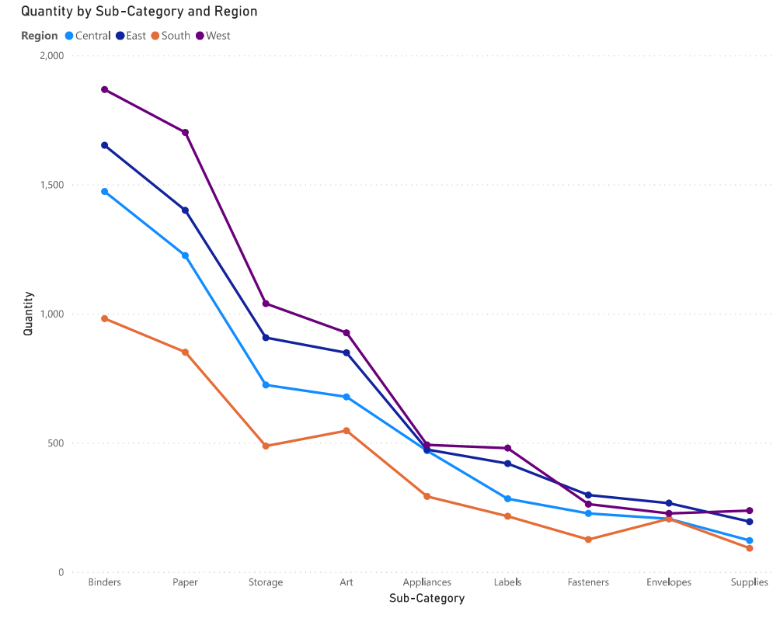
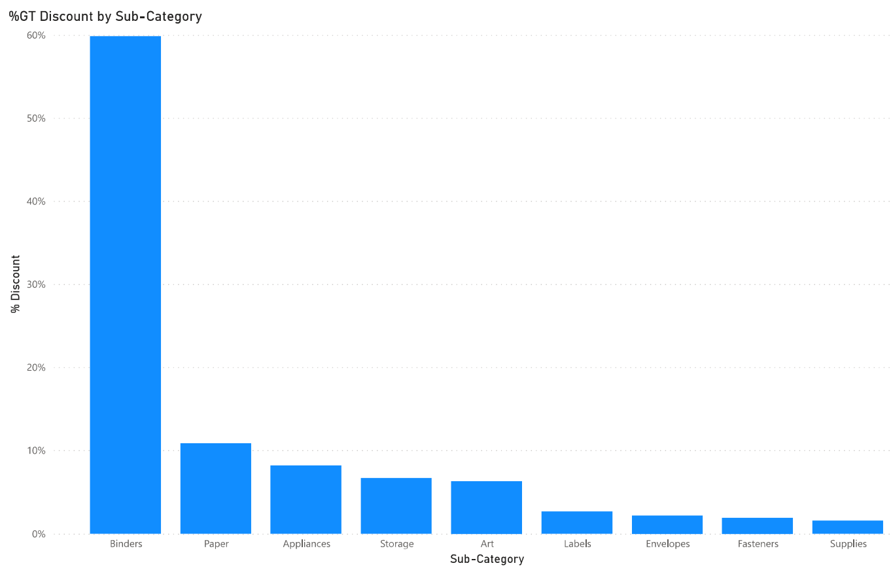
Highly manufactured in quantity and highly discounted products lead to higher Sales and Profit

Slide 7
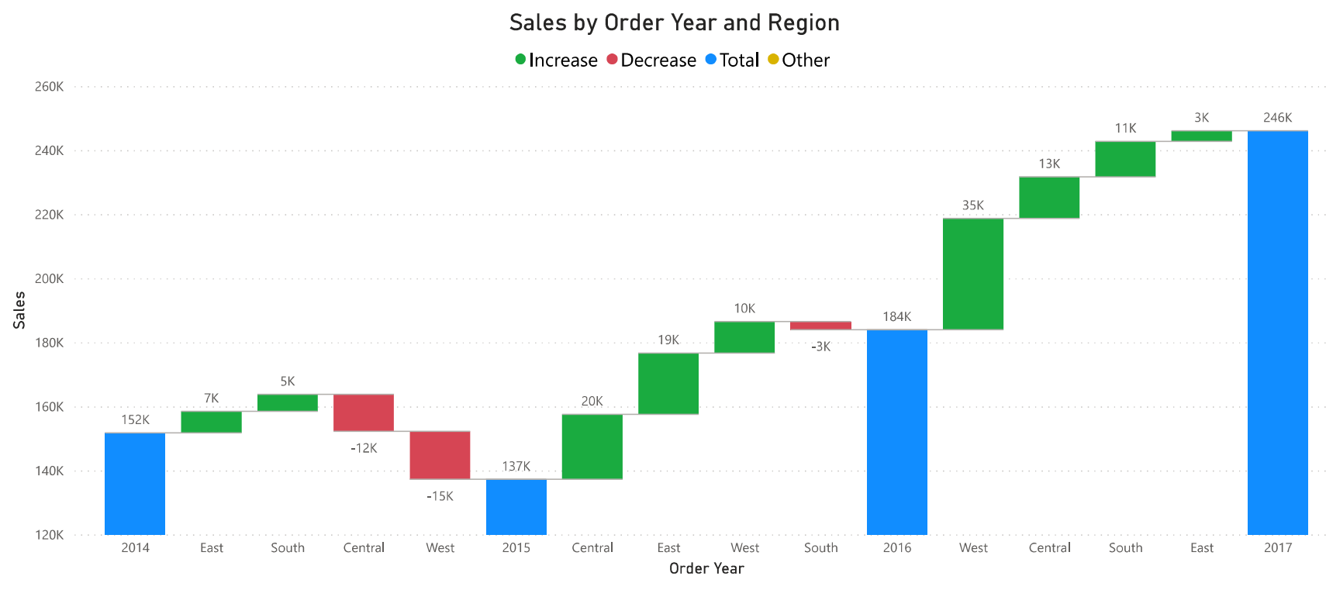
Year 2014, was bad in sales for Central and West, and year 2015 was bad for South region. But South region couldn’t recover as fast as compared to West.

Slide 8
Potential Solutions and Course of Actions to take:
Number of products manufactured for Labels, Envelopes, Fasteners and Supplies categories must be increased.
Prize of products in these 4 categories is less compared to other main and bulky products so, sale for these products can be increased by selling them in combo and keeping reasonable discount on combo.
As Paper category products are selling good in market so Art supplies, Labels and Envelops can be sold for cheap prizes or for free until it becomes a habit of customers to purchase in combo.

